Slide 1
500 cities census tract
Project aimed at examining the 500 cities census tract of disease and geography in the United States

Slide 2
Introduction
his census tract shapefile for the 500 Cities project was extracted from the Census 2010 Tiger/Line database and modified to remove portions of census tracts that were outside of city boundaries.
This shapefile can be joined with 500 Cities census tract-level Data (GIS Friendly Format) in a geographic information system (GIS) to make maps at the census tract level.

Slide 3
Source of the Dataset
This census tract shapefile for the 500 Cities project was extracted from the Census 2010 Tiger/Line database and modified to remove portions of census tracts that were outside of city boundaries. This shapefile can be joined with 500 Cities census tract-level Data (GIS Friendly Format) in a geographic information system (GIS) to make maps at the census tract level.
https://chronicdata.cdc.gov/500-Cities-Places/500-Cities-Census-Tract-Boundaries/x7zy-2xmx

Slide 4
Project Deliverables
Create a model to predict the distribution level of tract diseases across 500 cities in the United States

Slide 5
Libraries used
import pandas as pd
import numpy as np
import matplotlib.pyplot as plt
import plotly.express as px
import seaborn as sns
import pandas_profiling
from sklearn.preprocessing import StandardScaler, MinMaxScaler, MaxAbsScaler, QuantileTransformer
from sklearn.feature_selection import SelectKBest, f_classif
%matplotlib inline
from pathlib import Path
from pandas_profiling import ProfileReport

Slide 6
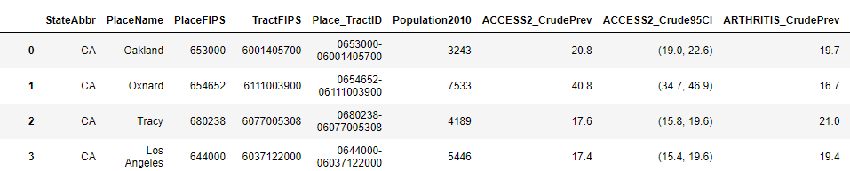
Snippet of the dataset

Slide 7
Cleaning the data
df.head(10)
df.tail(10)
df.info()
df.describe()
Finding missing values df.isnull()
sns.heatmap(df.isnull(),yticklabels=False,cbar=False,cmap="viridis")
Detecting outliers

Slide 8
Observations on results
The dataset contains 27210 observations
There are no missing values in the dataset
The dataset has 63 numerical values

Slide 9
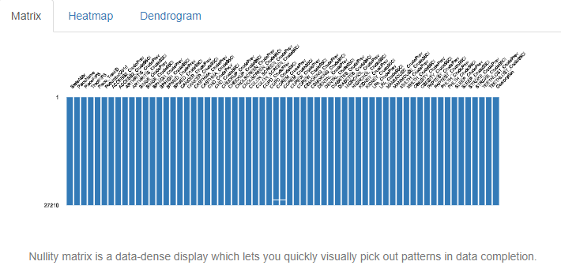
Missing value Matrix

Slide 10
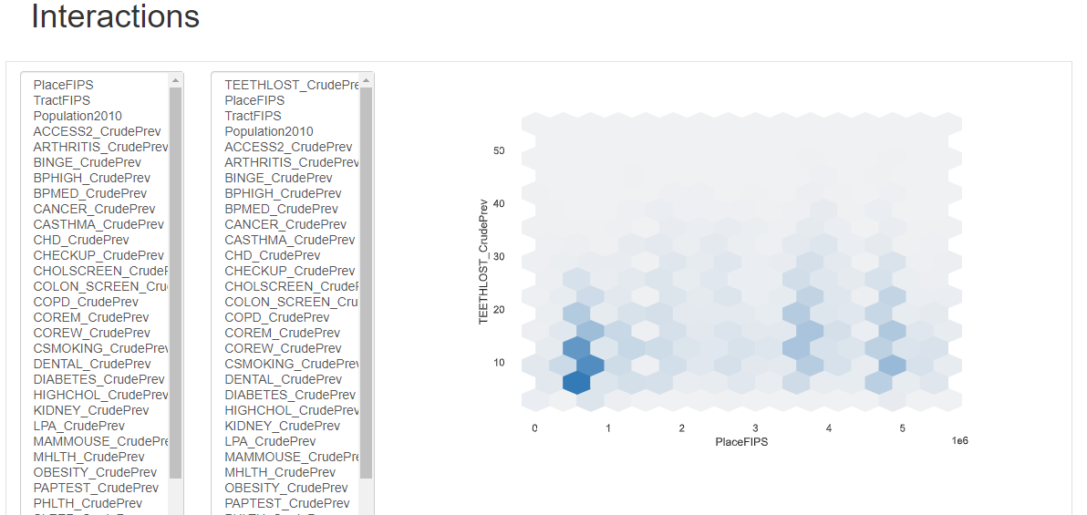
Check for Interactions

Slide 11
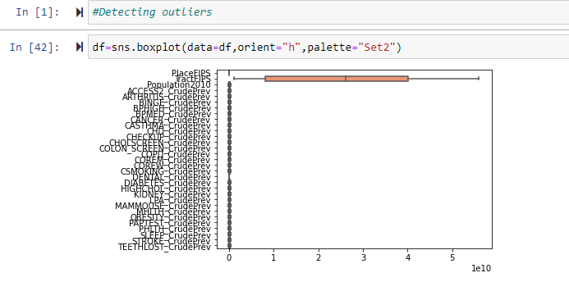
Detecting outliers

Slide 12
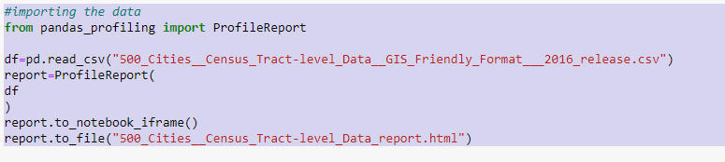
Automated EDA

Slide 13
Profiling report terms
Reproduction:Analysis started,Analysis finished,Duration,Version,Command line,Download configuration
Warnings
Type inference: detect the types of columns in a dataframe such as Boolean, Numerical, Date, Categorical, URL, Path, File and Image.
Dataset statistics: Number of variable,Number of observation,Missing cells,Missing cells(%),Duplicate rows,Duplicate rows(%),Total size in memory Average record size in memory
Essentials: type,unique values,missing values,infinite
Quantile statistics: minimum value,5th percentile,Q1,median,Q3,95th percentile,maximum,range,interquartile range
Descriptive statistics: mean,median,standard deviation,variance,sum,median absolute deviation,coefficient of variation,kurtosis,skewness
Most frequent values
Histogram
Extreme Values:minimum and maximum five values
Correlations: Spearman,Pearson,Kendall,Phik
Missing values matrix,distinct count,heatmap,dendrogram

Slide 14
Conclusion
In a nutshell, there is a positive correlation between the number of households in a city and the number of family households.
Specifically, the data shows that people with higher income tend to have better health outcomes.
There is a significant amount of variation in census tract boundaries across the United States.

